Slide 1

APBD – lecture 6
Delegates
LINQ Lambda
Extension methods
Anonymous types

Slide 2
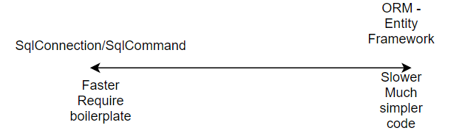
Interaction with database

Slide 3
C# - multiparadigm languages
C# is an objective language
However with the next versions of the C# language we can see a shift towards functional programming.
Nowadays we can see that a lot of languages „traditionally” object oriented are gaining more functional features.

Slide 4
Objective vs functional programming
Objective programming - usually the first-class citizen is a class. This is a way most of us are used to think about the programs – as a set of classes communicating with each other.
Functional programming – is a paradigm which concentrates on computing the result rather than on performing actions. This way of approaching a problem is often more suitable than objective way of thinking.

Slide 5
Functional programming
Functional programming have a lot of benefits and characteristics which we won’t discuss here like:
First-Class functions
Lazy evaluation
Higher-order functions
Immutability
Modularity
No side-effects
Lazy evaluation
Recursive function calls

Slide 6
C# multiparadigm language
Nowadays in C# and a lot of other languages including Java we can see a lot of features close to functional programming.
We will use some of those features in C# language when working with more complex libraries for ex. for database communication.

Slide 7
Delegates in C#
On of the elements of C# language that appeared very early are delegates. This is type-safe mechanism which enables us to pass, return and use functions as parameters.
We can think about it as a type-safe function pointer

Slide 8
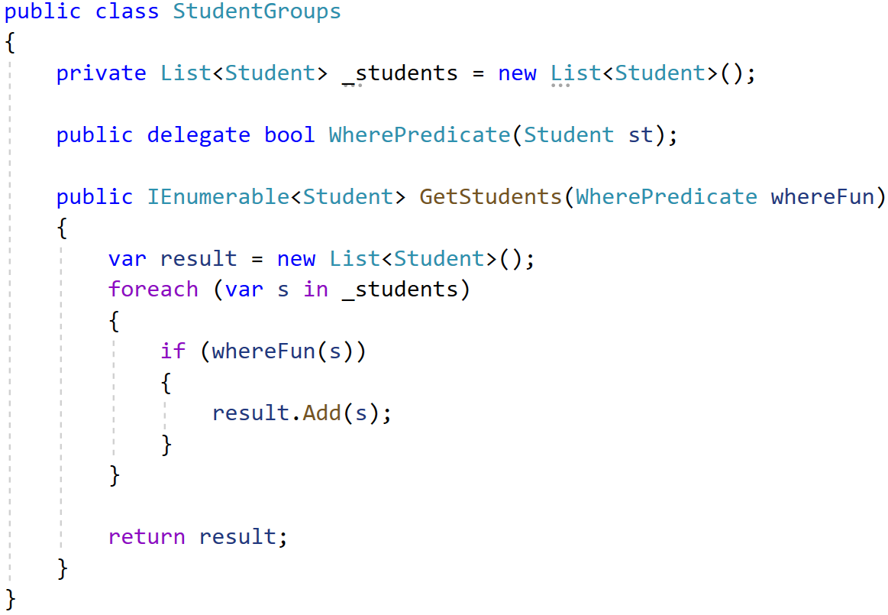
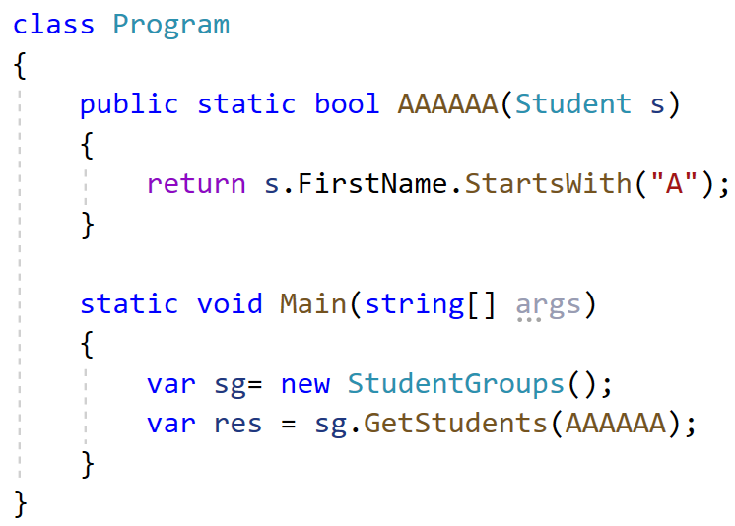
Delegates in C#

Slide 9
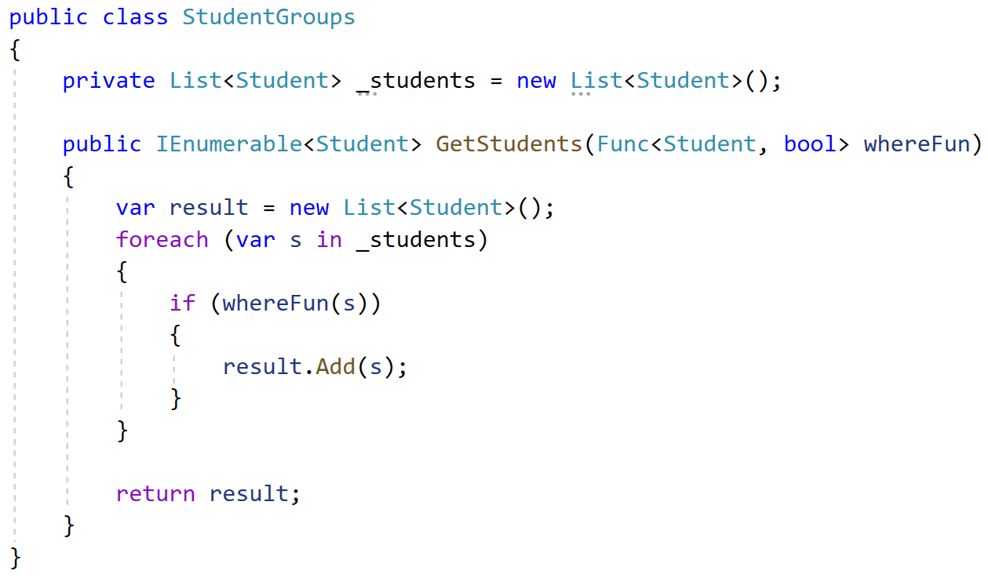
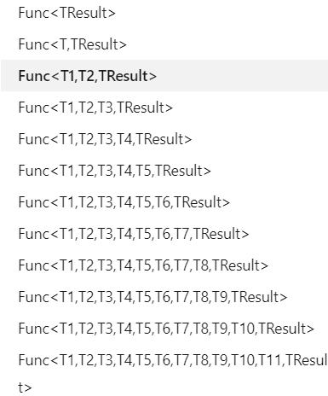
Generic delegates – Func<T> and Acion<T>

Slide 10
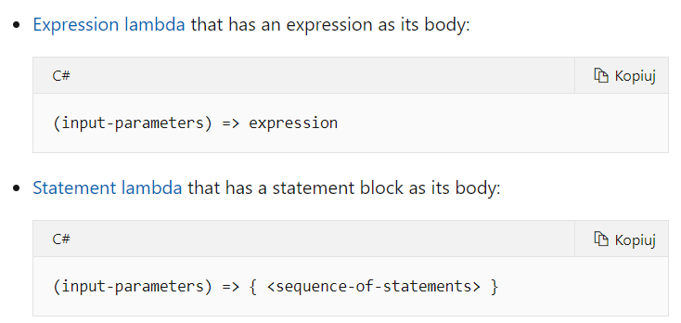
Lambda expressions
Lambda expression allows us create an anonymous function.
Use the lambda declaration operator => to separate the lambda's parameter list from its body.

Slide 11
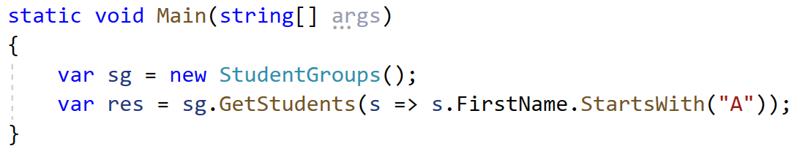
Lambda expressions - example

Slide 12
Extension methods
Extension methods enable you to "add" methods to existing types without creating a new derived type, recompiling, or otherwise modifying the original type.
Extension methods are static methods, but they're called as if they were instance methods on the extended type.
The most common extension methods are the LINQ standard query operators that add query functionality to the existing System.Collections.IEnumerable and System.Collections.Generic.IEnumerable<T> types.

Slide 13
Extension methods
Extension methods are additional custom methods which were originally not included with the class.
Extension methods can be added to custom, .NET Framework or third party classes, structs or interfaces.
The first parameter of the extension method must be of the type for which the extension method is applicable, preceded by this keyword.
Extension methods can be used anywhere in the application by including the namespace of the extension method.

Slide 14
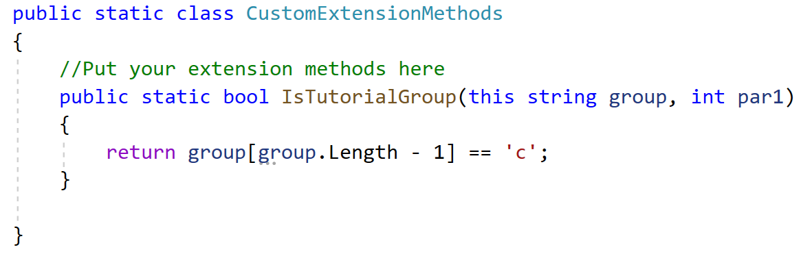
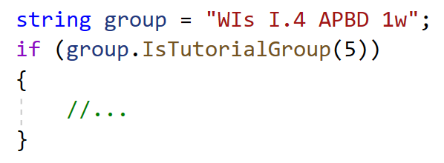
Extension methods - example

Slide 15
Anonymous types
In C#, an anonymous type is a type (class) without any name that can contain public read-only properties only. It cannot contain other members, such as fields, methods, events, etc.
You create an anonymous type using the new operator with an object initializer syntax. The implicitly typed variable- var is used to hold the reference of anonymous types.

Slide 16
Anonymous types
The following example demonstrates creating an anonymous type variable student that contains three properties named Id, FirstName, and LastName.
The properties of anonymous types are read-only and cannot be initialized with a null, anonymous function, or a pointer type. The properties can be accessed using dot (.) notation, same as object properties. However, you cannot change the values of properties as they are read-only.

Slide 17
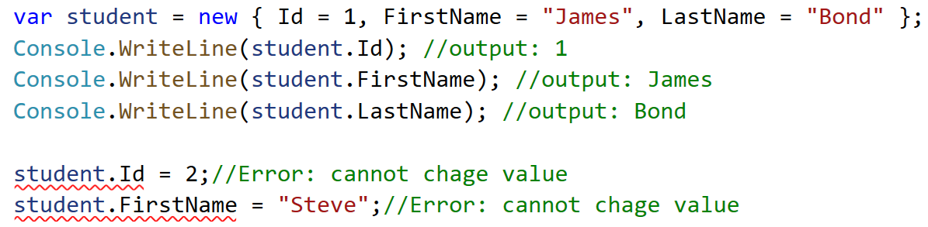
Anonymous types

Slide 18
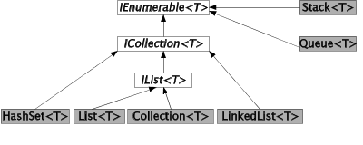
Collections hierarchy

Slide 19
LINQ – Language Integrated Query
Language-Integrated Query (LINQ) is the name for a set of technologies based on the integration of query capabilities directly into the C# language.
We can use it on any object implementing IEnumerable<T>
Introduced in .Net 3.5
LINQ (Language Integrated Query) is uniform query syntax in C# and VB.NET to retrieve data from different sources and formats.

Slide 20
LINQ – Language Integrated Query
LINQ can often be used with different data sources – for ex. relational databases, XML documents etc. (we need additional libraries for that).
We will use LINQ with database next week.

Slide 21
LINQ – syntax
Methods related to LINQ reside in System.Linq namespace
LINQ provides two ways of writing queries:
Query Syntax or Query Expression Syntax
Method Syntax or Method Extension Syntax or Fluent
We can mix both of them.
The method syntax is more expressive – there are things which we cannot do in query syntax

Slide 22
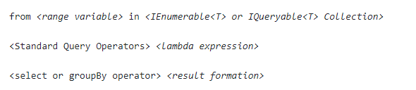
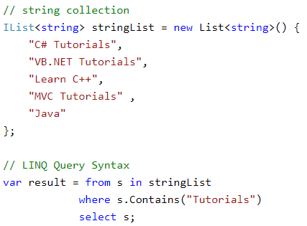
LINQ – query syntax

Slide 23
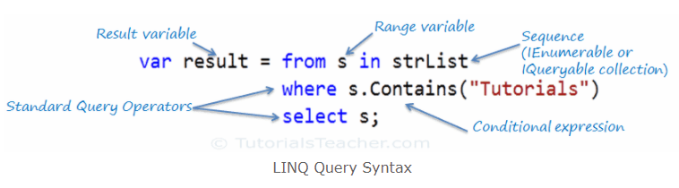
LINQ – query syntax
https://www.tutorialsteacher.com/linq/linq-query-syntax

Slide 24
LINQ – method syntax
Method syntax (also known as fluent syntax) uses extension methods included in the Enumerable or Queryable static class, similar to how you would call the extension method of any class.
The compiler converts query syntax into method syntax at compile time.
Using the method syntax we will rely on Lambda expressions, extension methods and anonymous types

Slide 25
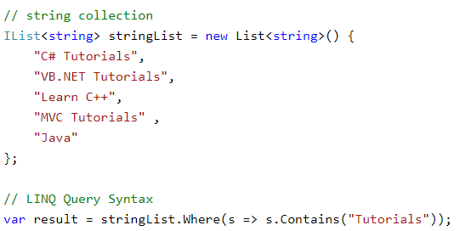
LINQ – method syntax

Slide 26
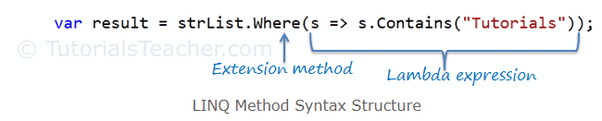
LINQ – method syntax
https://www.tutorialsteacher.com/linq/linq-method-syntax

Slide 27
LINQ – example of methods in both syntaxes
https://docs.microsoft.com/en-us/samples/dotnet/try-samples/101-linq-samples/
https://linqsamples.com/

Slide 28
Bibliography
https://hamidmosalla.com/2019/04/25/functional-programming-in-c-sharp-a-brief-guide/
https://www.infoq.com/presentations/c-sharp-functional-features/
https://www.youtube.com/watch?v=v7WLC5As6g4
https://docs.microsoft.com/pl-pl/dotnet/csharp/programming-guide/concepts/linq/
http://people.cs.aau.dk/~normark/oop-csharp/html/notes/collections_themes-list-sect.html
https://docs.microsoft.com/pl-pl/dotnet/csharp/programming-guide/classes-and-structs/extension-methods
https://www.tutorialsteacher.com/csharp/csharp-anonymous-type
https://www.tutorialsteacher.com/linq/linq-query-syntax
https://www.tutorialsteacher.com/linq/linq-method-syntax

